Slide 1
Lexical Analyzer

Slide 2
Role of Lexical Analyzer
It is the 1st phase of a compiler
the main task of the lexical analyzer is to,
read the input characters of the source program,
group them into lexemes,
and produce as output a sequence of tokens for each lexeme in the source program.

Slide 3
Role of Lexical Analyzer
The stream of tokens is sent to the parser for syntax analysis.
It is common for the lexical analyzer to interact with the symbol table as well.
When the lexical analyzer discovers a lexeme constituting an identifier, it needs to enter that lexeme into the symbol table.

Slide 4
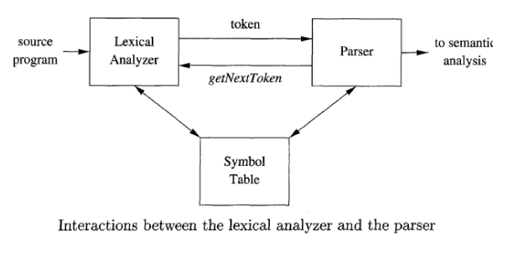
Lexical Analyzer

Slide 5
Lexical Analyzer
These interactions are suggested in figure.
Commonly, the interaction is implemented by having the parser call the lexical analyzer.
The call, suggested by the getNextToken command, causes the lexical analyzer to read characters from its input until it can identify the next lexeme and produce for it the next token, which it returns to the parser.

Slide 6
Lexical Analyzer
The lexical analyzer is the part of the compiler that reads the source text.
It may perform certain other tasks besides identification of lexemes.
One such task is stripping out comments and whitespace (blank, newline, tab, and perhaps other characters that are used to separate tokens in the input).

Slide 7
Lexical Analyzer
Another task is correlating error messages generated by the compiler with the source program.
For instance, the lexical analyzer may keep track of the number of newline characters seen, so it can associate a line number with each error message.
In some compilers, the lexical analyzer makes a copy of the source program with the error messages inserted at the appropriate positions.

Slide 8
Processes in Lexical Analyzer
Sometimes, lexical analyzers are divided into a cascade of two processes:
Scanning consists of the simple processes that do not require tokenization of the input, such as deletion of comments and compaction of consecutive whitespace characters into one.
Lexical analysis part is the more complex portion, where the scanner produces the sequence of tokens as output.

Slide 9
Token, Lexeme and Pattern
When discussing lexical analysis, we use three related but distinct terms:
A token
A pattern
A lexeme

Slide 10
Token
A token is a pair consisting of a token name and an optional attribute value.
The token name is an abstract symbol representing a kind of lexical unit, e.g., a particular keyword, or a sequence of input characters denoting an identifier.
The token names are the input symbols that the parser processes.
We shall generally write the name of a token in boldface.
We will often refer to a token by its token name.

Slide 11
Pattern
A pattern is a description of the form that the lexemes of a token may take.
In the case of a keyword as a token, the pattern is just the sequence of characters that form the keyword.
For identifiers and some other tokens, the pattern is a more complex structure that is matched by many strings.

Slide 12
Lexeme
A lexeme is a sequence of characters in the source program that matches the pattern for a token and is identified by the lexical analyzer as an instance of that token.

Slide 13
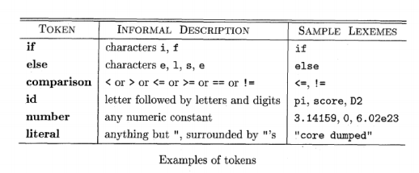
Token Vs. Lexeme

Slide 14
Token, Lexeme and Pattern
Figure gives some typical tokens, their informally described patterns, and some sample lexemes.

Slide 15
Lexical Analysis Vs. Parsing
There are a number of reasons why the analysis portion of a compiler is normally separated into lexical analysis and parsing (syntax analysis) phases.

Slide 16
Lexical Analysis Vs. Parsing
Simplicity of design is the most important consideration.
The separation of lexical and syntactic analysis often allows us to simplify at least one of these tasks.
For example, a parser that had to deal with comments and whitespace as syntactic units would be considerably more complex than one that can assume comments and whitespace have already been removed by the lexical analyzer.
If we are designing a new language, separating lexical and syntactic concerns can lead to a cleaner overall language design.

Slide 17
Lexical Analysis Vs. Parsing
Compiler efficiency is improved.
A separate lexical analyzer allows us to apply specialized techniques that serve only the lexical task, not the job of parsing.
In addition, specialized buffering techniques for reading input characters can speed up the compiler significantly.

Slide 18
Lexical Analysis Vs. Parsing
Compiler portability is enhanced.
Input-device-specific peculiarities can be restricted to the lexical analyzer.

Slide 19
Example
To see how these concepts are used in practice, in the C statement printf("Total = %d\n", score);} both printf and score are lexemes matching the pattern for token id, and "Total = %d\n" a lexeme matching literal.

Slide 20
Token, pattern , lexeme
In many programming languages, the following classes cover most or all of the tokens:
1. One token for each keyword. The pattern for a keyword is the same as the keyword itself.
2. Tokens for the operators, either individually or in classes such as the token comparison mentioned.
3. One token representing all identifiers.
4. One or more tokens representing constants, such as numbers and literal strings.
5. Tokens for each punctuation symbol, such as left and right parentheses, comma, and semicolon.

Slide 21
Attributes for Token
When more than one lexeme can match a pattern, the lexical analyzer must provide the subsequent compiler phases additional information about the particular lexeme that matched.
For example, the pattern for token number matches both 0 and 1, but it is extremely important for the code generator to know which lexeme was found in the source program.

Slide 22
Attributes for token
Thus, in many cases the lexical analyzer returns to the parser not only a token name, but an attribute value that describes the lexeme represented by the token.
The token name influences parsing decisions, while the attribute value influences translation of tokens after the parse.

Slide 23
Attributes for token
We shall assume that tokens have at most one associated attribute, although this attribute may have a structure that combines several pieces of information.
The most important example is the token id, where we need to associate with the token a great deal of information.

Slide 24
Example
Simple code snippet
int a,b,c;
a = 50;
float value() { b = a; }
if (b==a) { c = b;}

Slide 25
Output of Lexical Analyzer (Sequence of tokens)
<INT>
<ID, a>
<COMMA>
<ID, b>
<ID, c>
<SEMICOLON>
<ID, a>
<ASSIGNOP, =>
<NUMBER, 50>
<FLOAT>
<ID, value>
<PAREN, (>
<PAREN, )>
<PAREN, {>
<ID, b>
<ASSIGNOP, =>
<ID, c>
<PAREN, }>

Slide 26
How to identify the tokens?
Using a pattern, lexical analyzer will understand which lexeme will fall under which token.
Patterns can be expressed as regular expression.

Slide 27
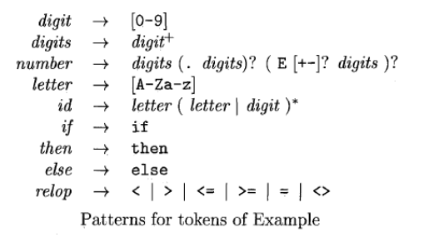
Examples of regular expressions

Slide 28
Problems of id and Keyword
Do you understand what is the problem for them to identify in lexical analyzer?
If you understand can you tell how to solve this problem?

Slide 29
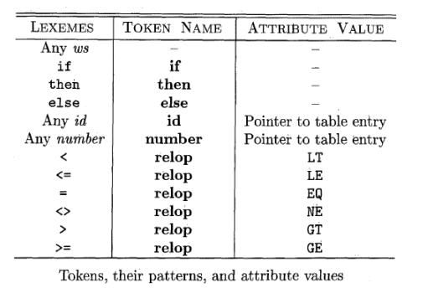
Example
The example is shown for fortran language. It will be much similar for C language.

Slide 30
Transition diagrams
As an intermediate step in the construction of a lexical analyzer, we first convert patterns into stylized flowcharts, called “transition diagrams.”
In this section, we perform the conversion from regular-expression patterns to transition diagrams by hand.
Transition diagrams have a collection of nodes or circles, called states.
Each state represents a condition that could occur during the process of scanning the input looking for a lexeme that matches one of several patterns.

Slide 31
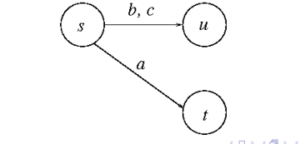
Simple Example of transition diagram

Slide 32
Basic Assumptions
We shall assume that all our transition diagrams are deterministic, meaning that there is never more than one edge out of a given state with a given symbol among its labels.
Later we shall relax the condition of determinism, making life much easier for the designer of a lexical analyzer, although trickier for the implementer.

Slide 33
Some conventions
Accepting state :
If the final state come from such thing which does not present in the lexeme, then the final state has a *.
The final or accepting also mention the return value of the lexical analyzer.
The diagram starts with a start state.

Slide 34
Transition diagram for relational operators
Known relational operators are:
<, <= , >, >=, ==, !=
How can we draw?

Slide 35
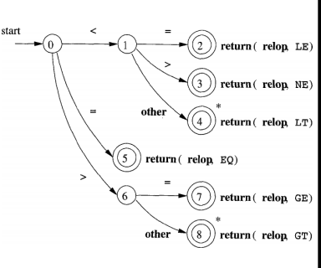
Relational Operator

Slide 36
What will be the diagram for number?
Integer(3/314/115)
Float/double(3.14/3.1416) / (3.14E678/3.14E+678/3.14E-678/3E678)

Slide 37
Transition Diagrams
For keywords (Like : if, else, for, int, float…)
For identifiers/ids (Like: variable names, function names)
For whitespace
Can you draw these???

Slide 38
Architecture of a transition diagram based Lexical Analyzer
We have seen/can draw transition diagrams for each tokens (Example: Number, ReLop, ID, Keywords : if, else, for…. )
There are several ways that a collection of transition diagrams can be used to build a lexical analyzer.
Regardless of the overall strategy, each state of the transition diagram is represented by a piece of code.
We may imagine a variable state holding the number of the current state for a transition diagram.
A switch based on the value of state takes us to code for each of the possible states, where we find the action of that state.

Slide 39
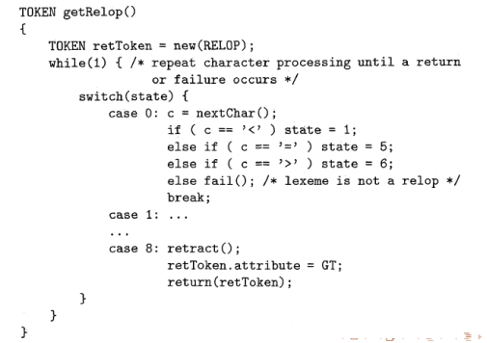
Architecture of a transition diagram based Lexical Analyzer

Slide 40
Architecture of a transition diagram based Lexical Analyzer
The code is shown in cpp for converting a transition diagram to code format in order to get our desired lexical analyzer.
It is code for the transition diagram of the relational operator of fortran language (page 35).
We can write it for the transition diagram of C code.
Switch is for checking the state(0/1/2/....).
If multiple ways from one state then there is if/else if statements.
If in the final/accepting state, then corresponding value have to be returned.

Slide 41
More Information about the code
Token is a class.
This class has a property named “attribute” which carries the lexeme used in the code. (Like : <= / >=/ ==/…)
retract() is a declared function to handle the star mark (*) in the final state.
A function nextchar() obtains the next character from the input and assigns it to local variable c.

Slide 42
More Information about the code
Function getRelop() returns an object of type TOKEN, that is, a pair consisting of the token name relop and an attribute value (the code for one of the six compariso operators in this case).
getRelop() first creates a new object retToken and initializes its first component to RELOP, the symbolic code for token relop.
If nothing matches with the pattern then it will eventually go to the fail(). This is another function defined in the code. This function will take to check the lexeme to compare with another pattern or may return to an error(!).

Slide 43
Architecture of a transition diagram based Lexical Analyzer
1. We could arrange for the transition diagrams for each token to be tried sequentially.
This method allows us to use transition diagrams for the individual keywords.
We have only to use these before we use the diagram for id, in order for the keywords to be reserved words.

Slide 44
Architecture of a transition diagram based Lexical Analyzer
2. We could run the various transition diagrams “in parallel,” feeding the next input character to all of them and allowing each one to make whatever transitions it required.
If we use this strategy, we must be careful to resolve the case where one diagram finds a lexeme that matches its pattern, while one or more other diagrams are still able to process input.
The normal strategy is to take the longest prefix of the input that matches any pattern.
That rule allows us to prefer identifier thenext to keyword then, or the operator -> to -, for example.

Slide 45
Architecture of a transition diagram based Lexical Analyzer
3. The preferred approach, is to combine all the transition diagrams into one.
We allow the transition diagram to read input until there is no possible next state.
And then take the longest lexeme that matched any pattern, as we discussed in item (2) above.
But this architecture may have some problems for complex tokens. (While two tokens may have same pattern initially)

Slide 46
Lexical Errors
It is hard for a lexical analyzer to tell, without the aid of other components, that there is a source-code error.
For instance, if the string fi is encountered for the first time in a C program in the context: fi ( a == f(x)) dots a lexical analyzer cannot tell whether fi is a misspelling of the keyword if or an undeclared function identifier.
Since fi is a valid lexeme for the token id, the lexical analyzer must return the token id to the parser and let some other phase of the compiler — probably the parser in this case — handle an error due to transposition of the letters.

Slide 47
Lexical Errors
Suppose a situation does arise in which the lexical analyzer is unable to proceed because none of the patterns for tokens matches a prefix of the remaining input.
Perhaps the simplest recovery strategy is “panic mode” recovery.
We delete successive characters from the remaining input until the lexical analyzer can find a well-formed token.
This recovery technique may occasionally confuse the parser, but in an interactive computing environment it may be quite adequate.

Slide 48
Lexical Errors
Other possible error-recovery actions are:
deleting an extraneous character,
inserting a missing character,
replacing an incorrect character by a correct character,
transposing two adjacent characters

Slide 49


